Slide 1

Codergirl – Frontend
Unit 2 - Class 10
Jan 11, 2021
Notes:
1

Slide 2
Agenda
Section 15 – Forms – Reactive Approach
Studio – Assignment # 7 and Section 16.
Notes:
2

Slide 3
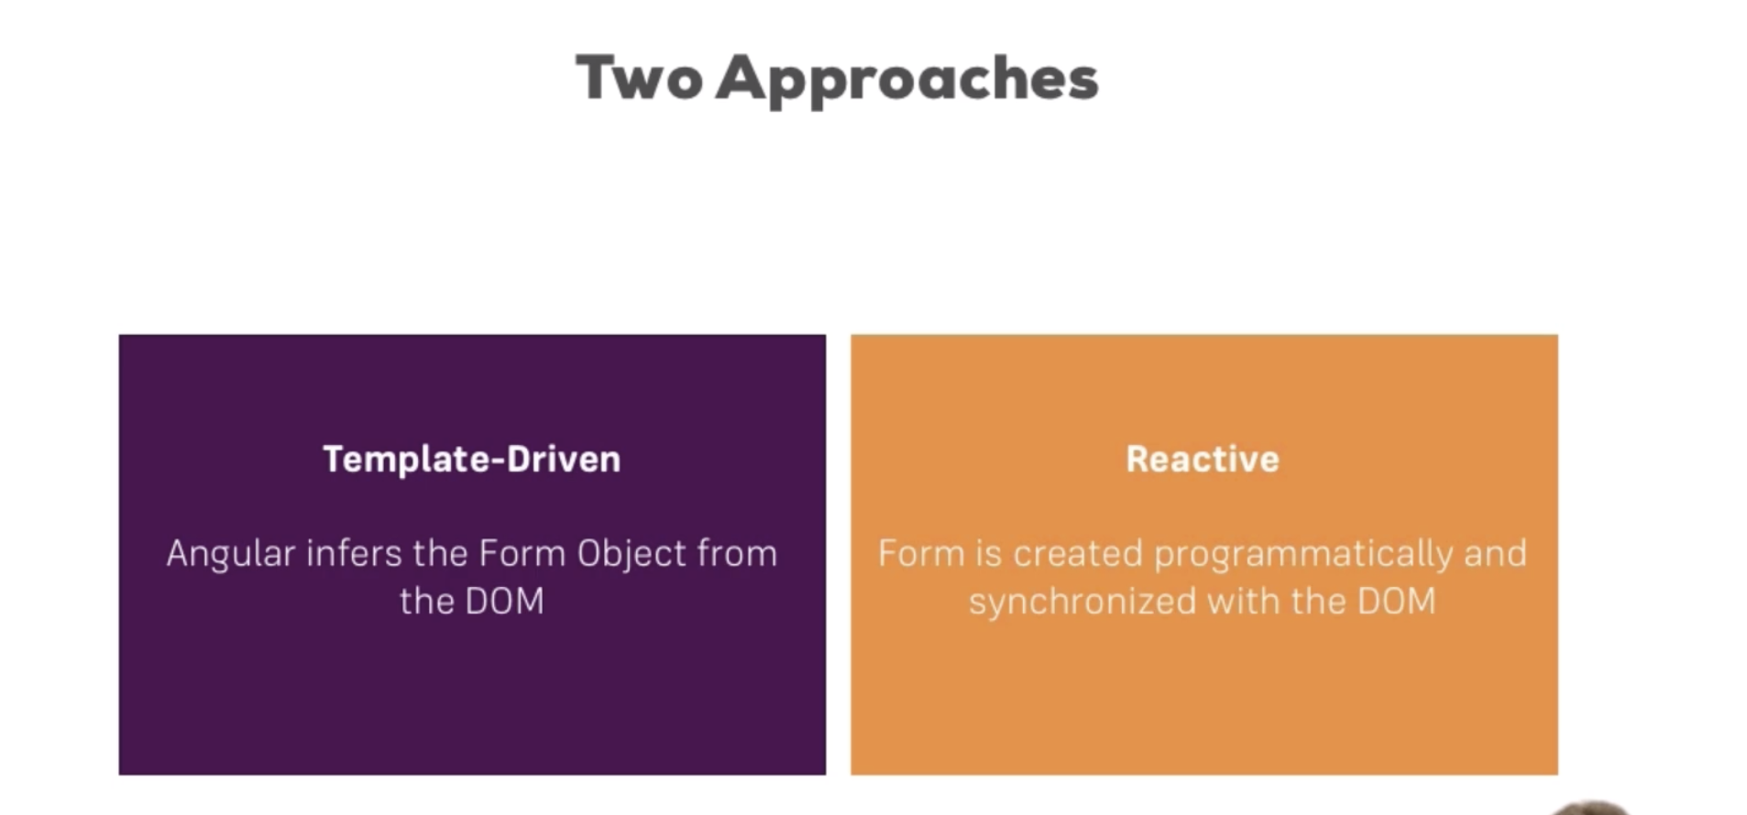
Notes:
Cerate the form programatically with greater detail.
3

Slide 4
Forms
Notes:
4

Slide 5
Creating a form in code
Notes:
5

Slide 6
Syncing HTML and form
Notes:
6

Slide 7
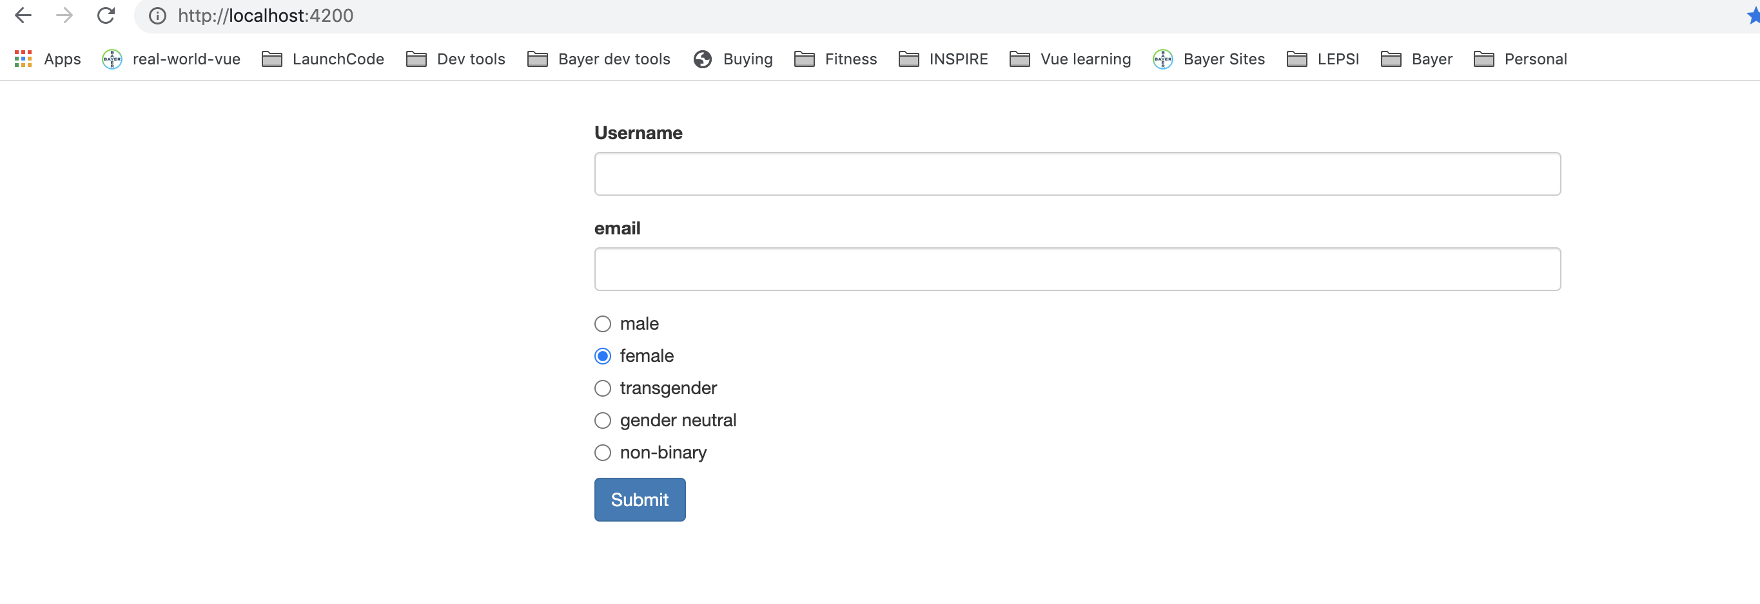
the form
Notes:
7

Slide 8
Submitting the form
Notes:
8

Slide 9
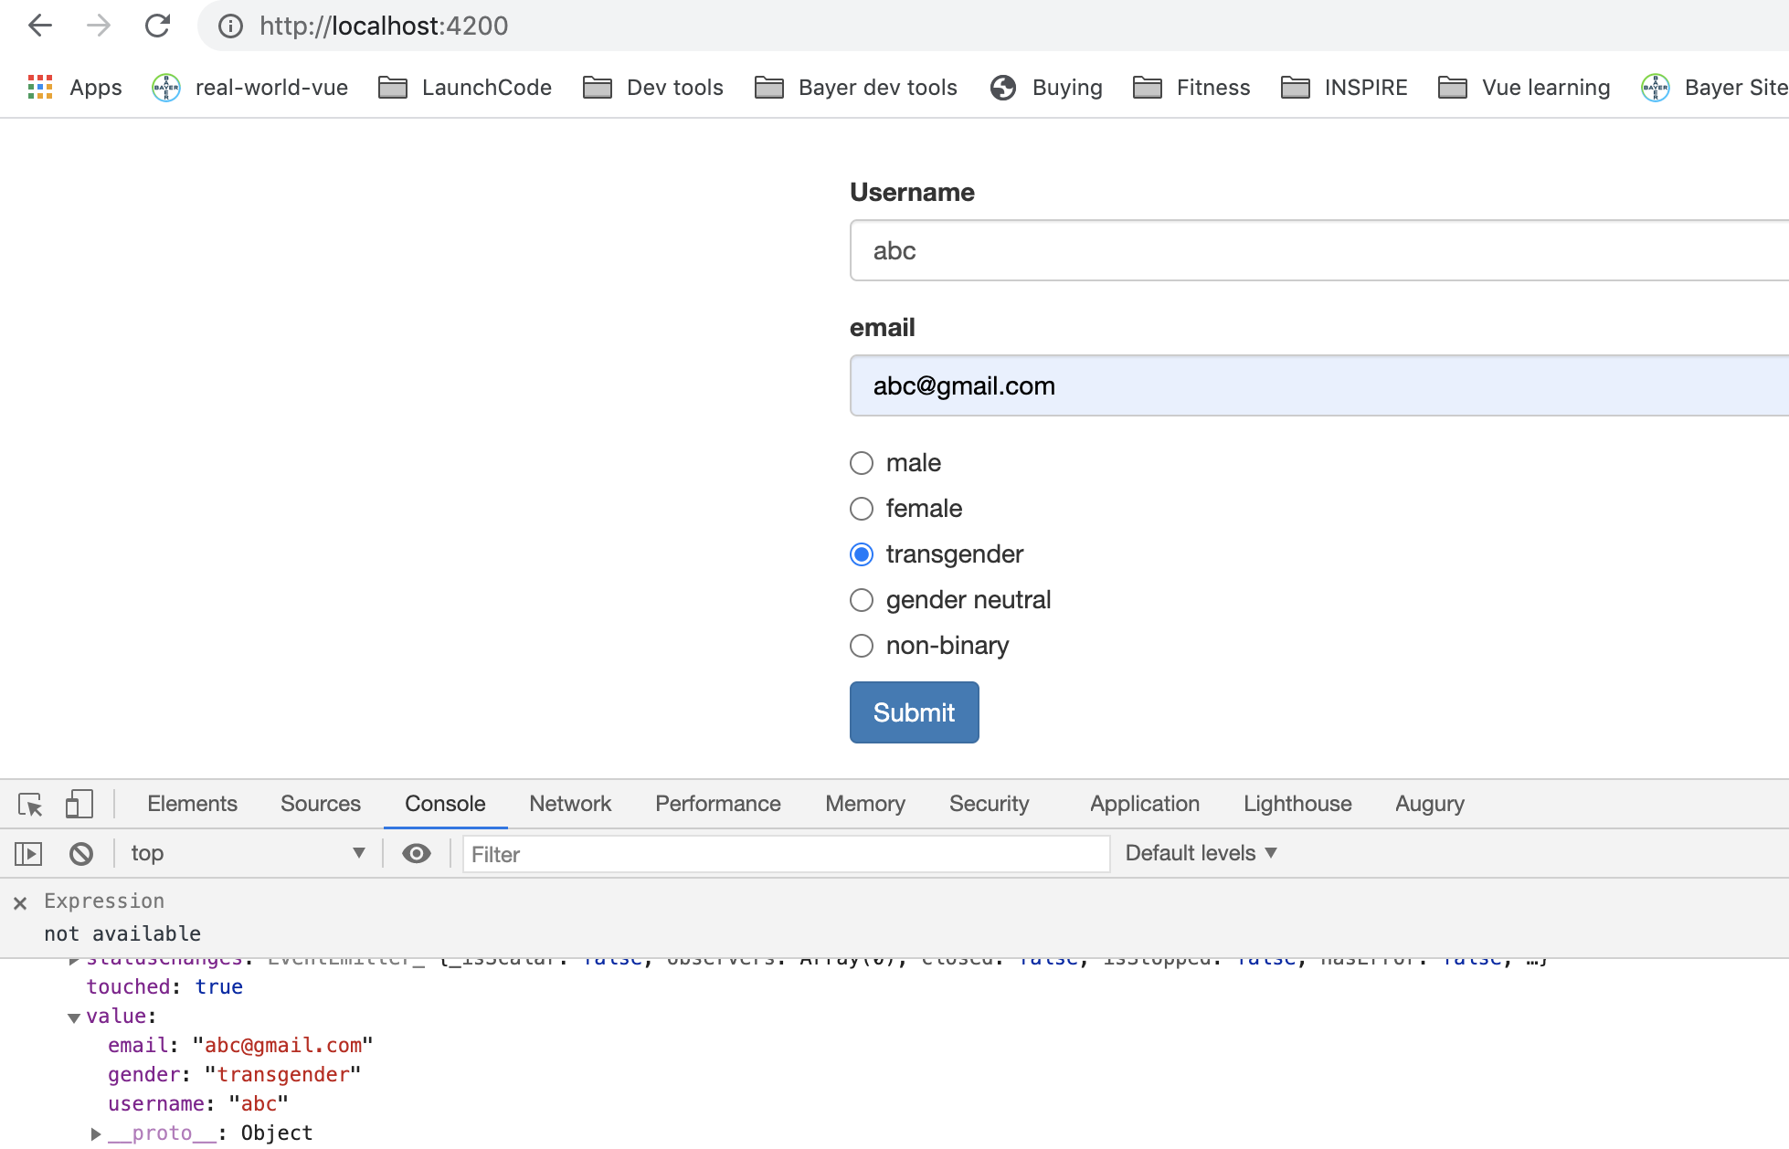
Submitting the form
Notes:
Reactive approach is cool that the model in the form matches what you setup in TS code.
9

Slide 10
Form Validations
Template driven approach adds validation to template.
Reactive approach is different. Validator added in code. Reference to Validator (not execute it).
Notes:
10

Slide 11
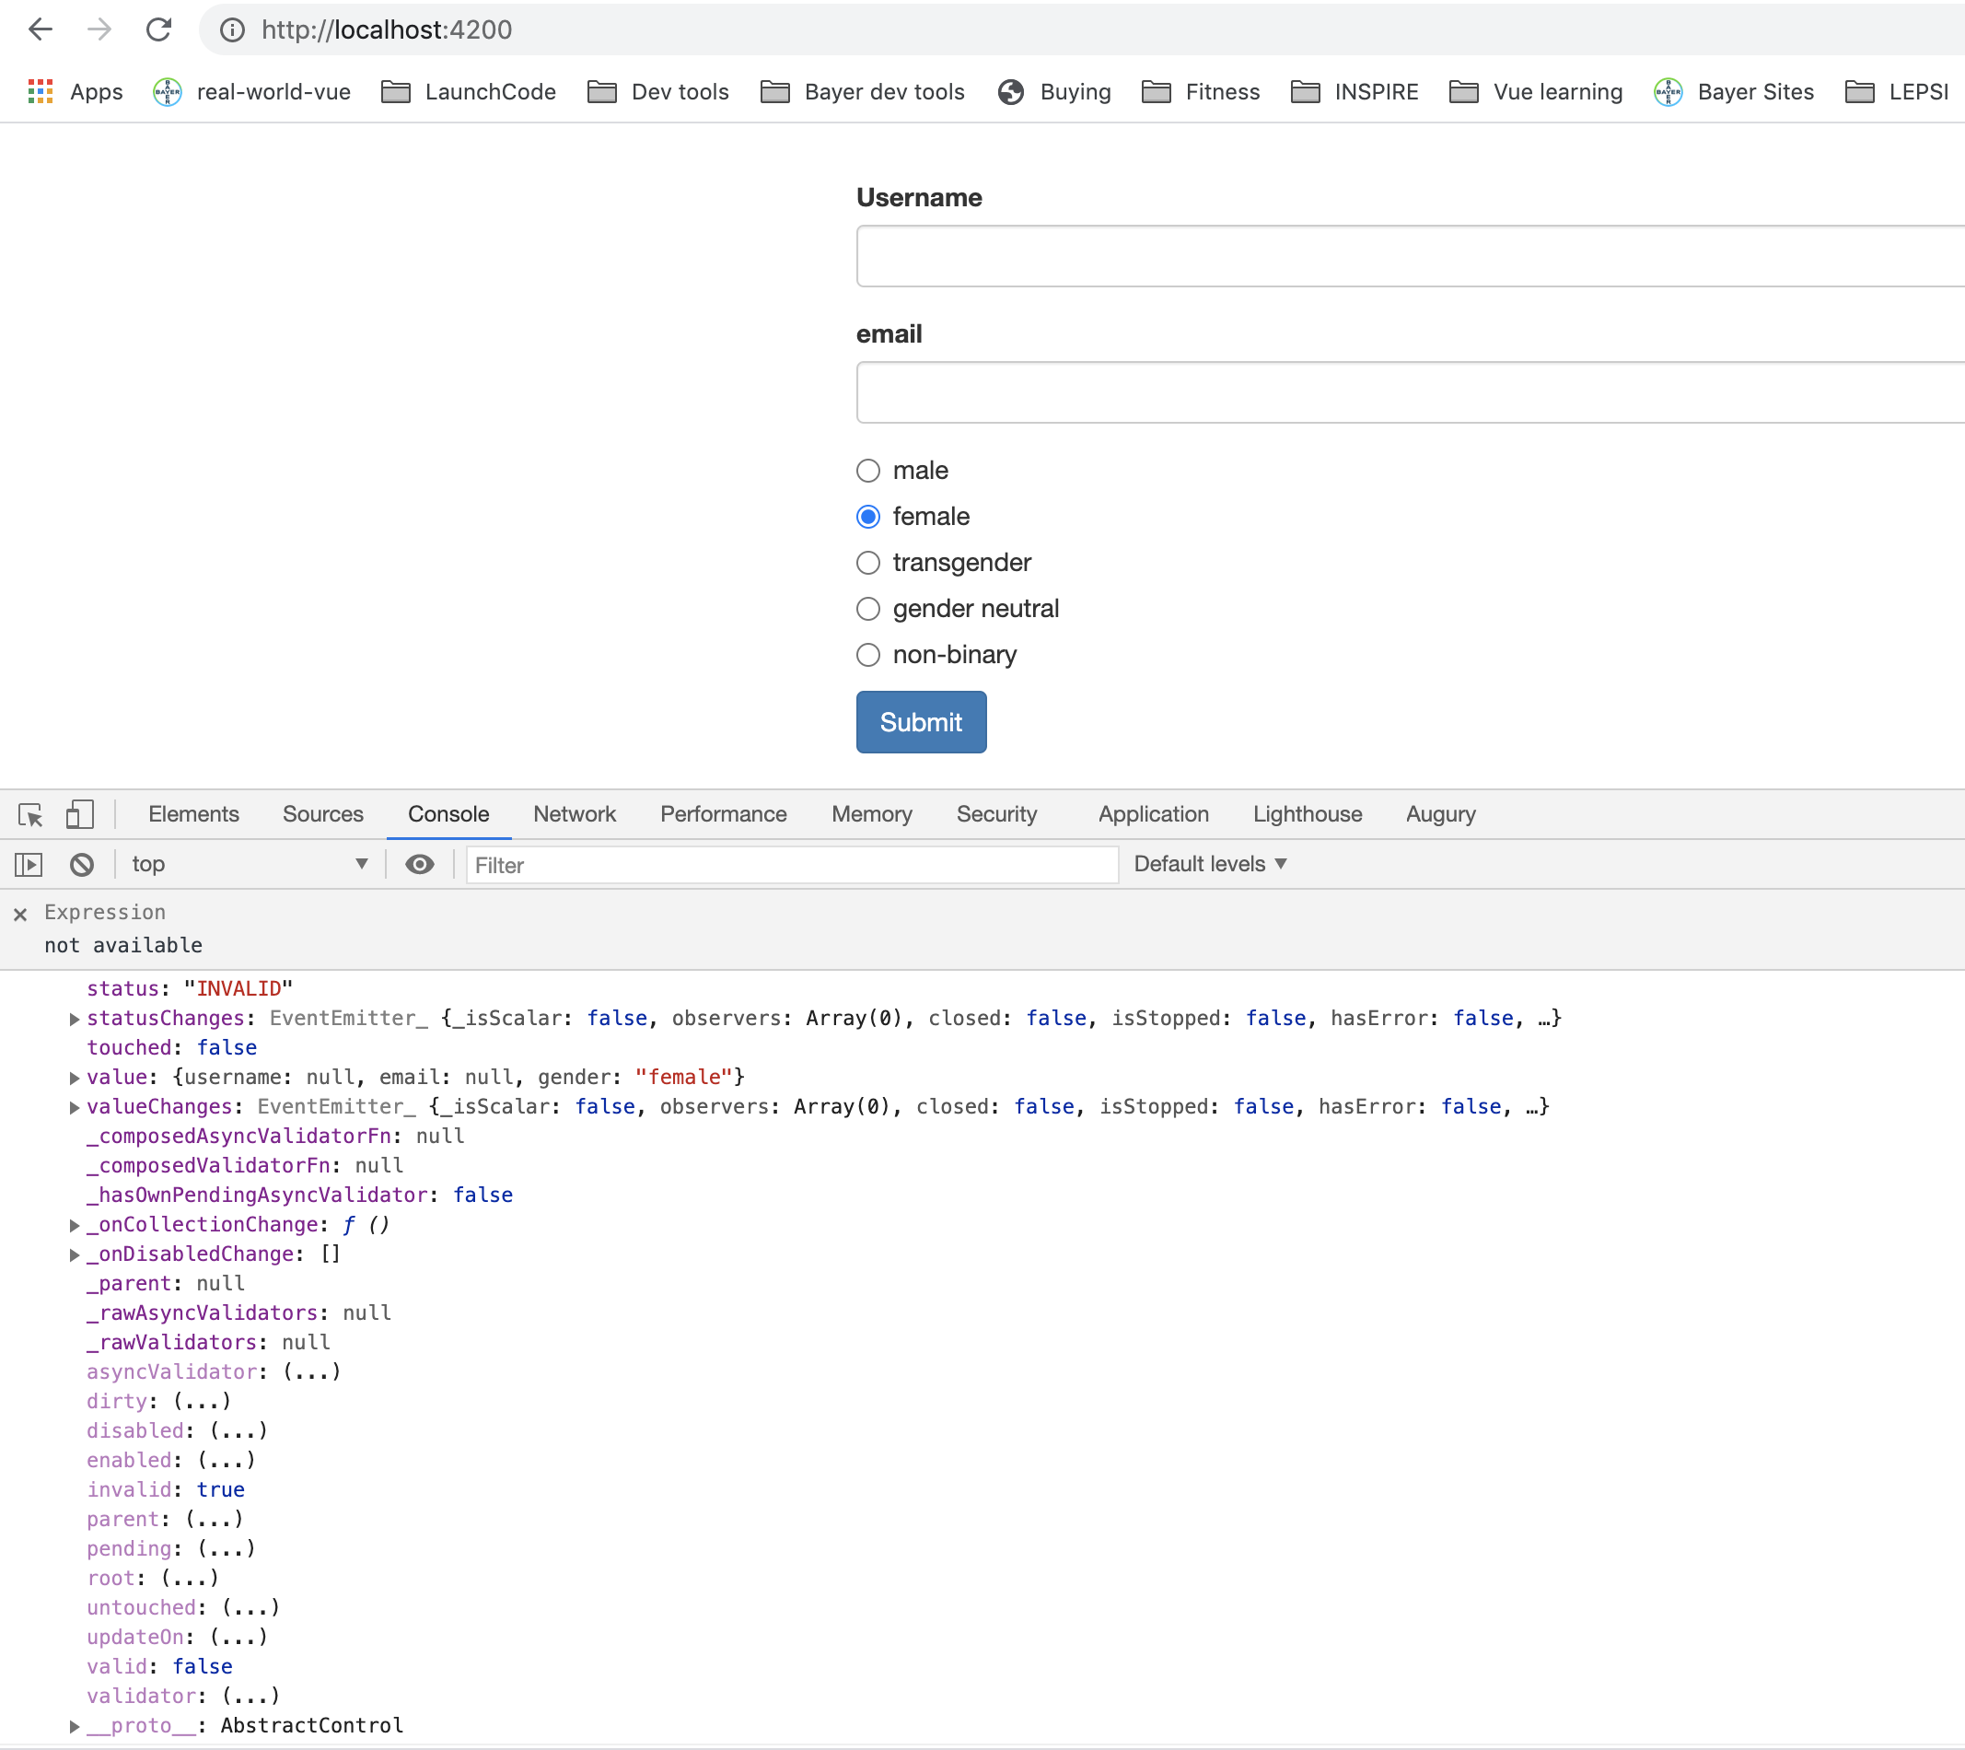
Form Validations
Notes:
11

Slide 12
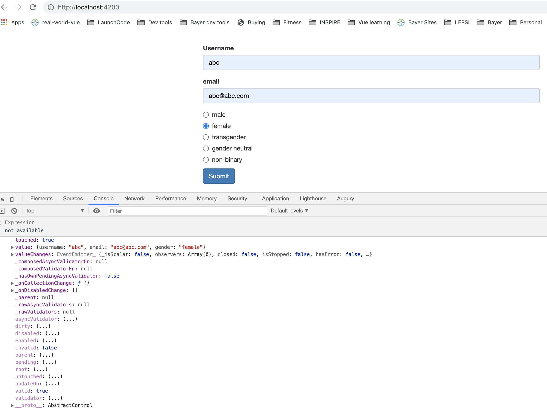
Form Validations
Notes:
12

Slide 13
Getting Access to Controls.
Notes:
13

Slide 14
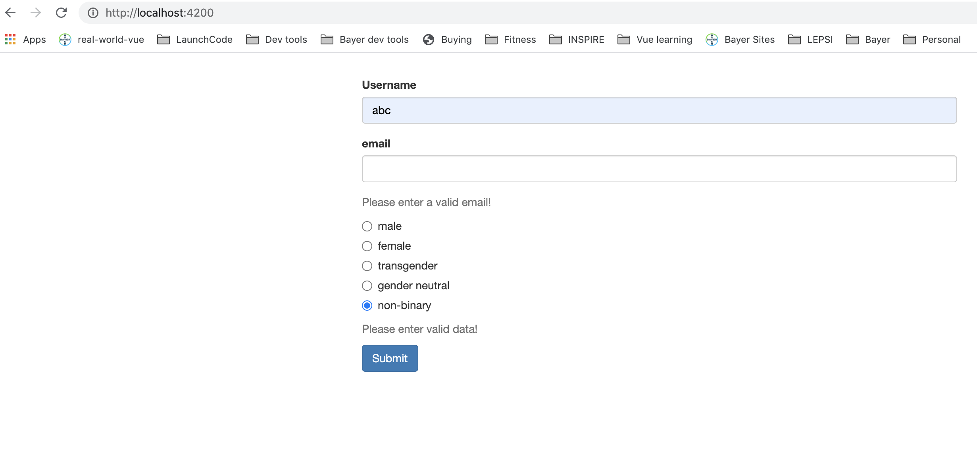
Getting Access to Controls.
Notes:
14

Slide 15
Add styling
Notes:
15

Slide 16
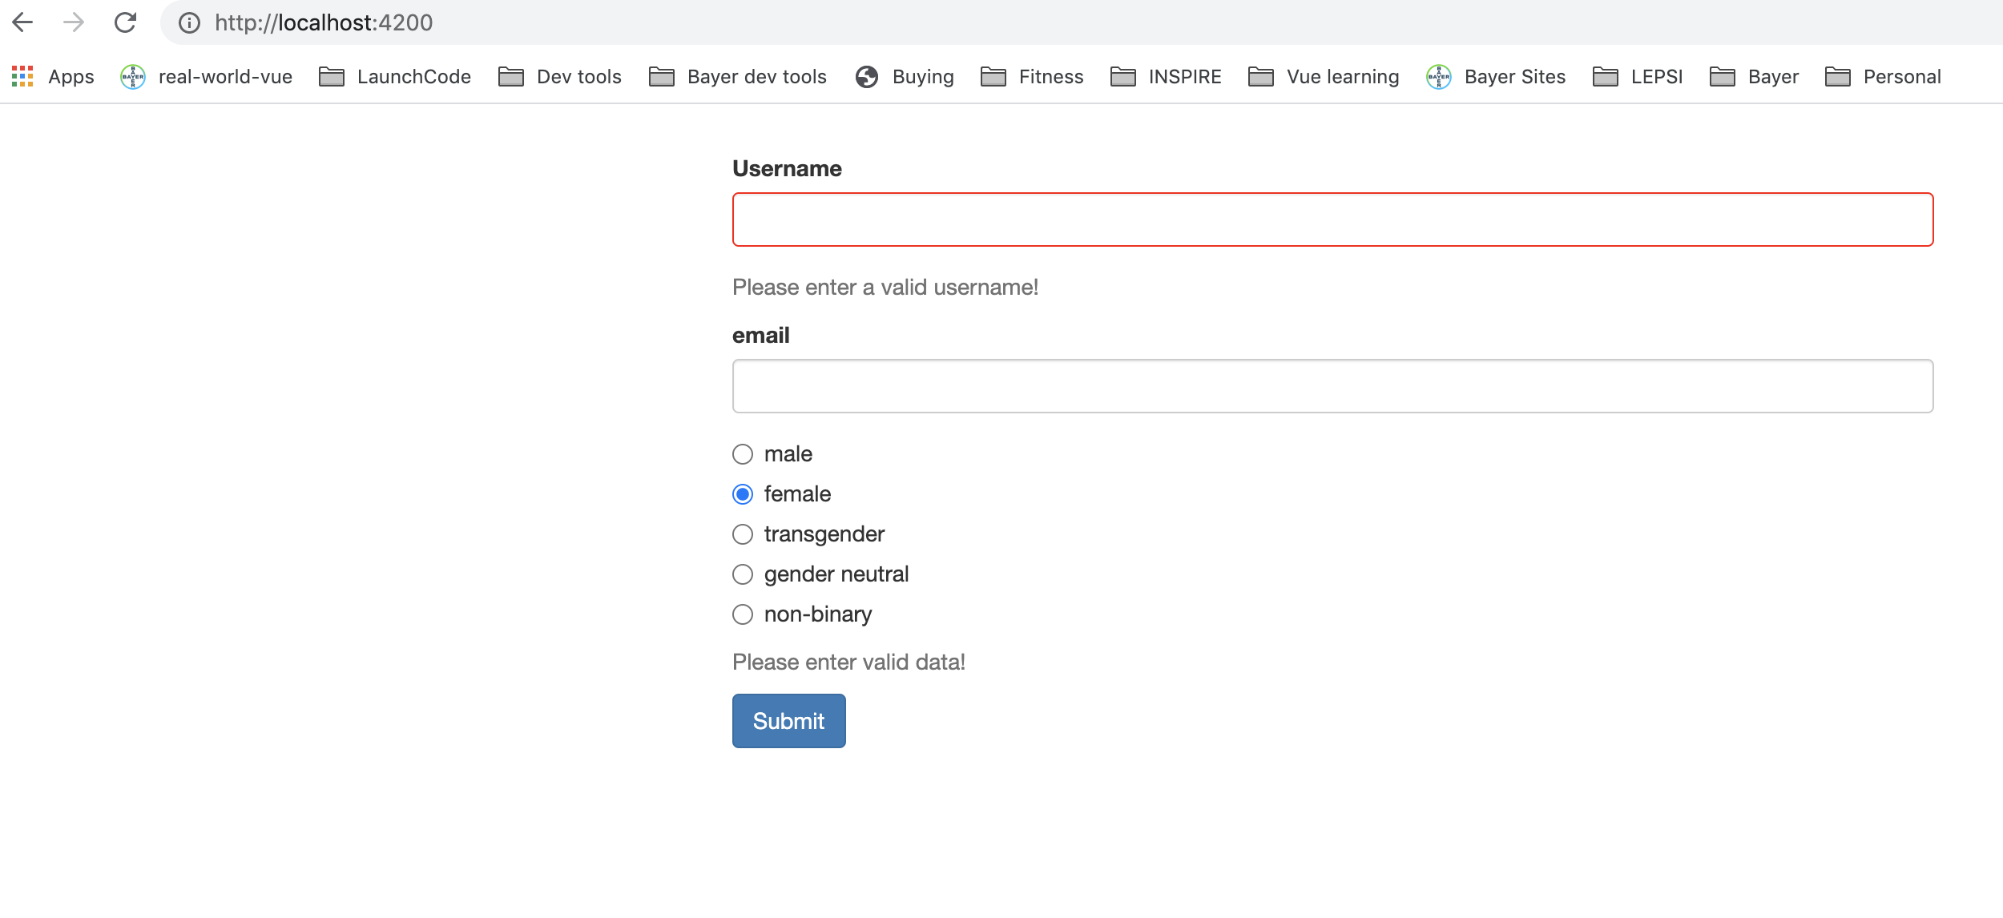
Add styling
Notes:
16

Slide 17
Grouping Controls
Notes:
17

Slide 18
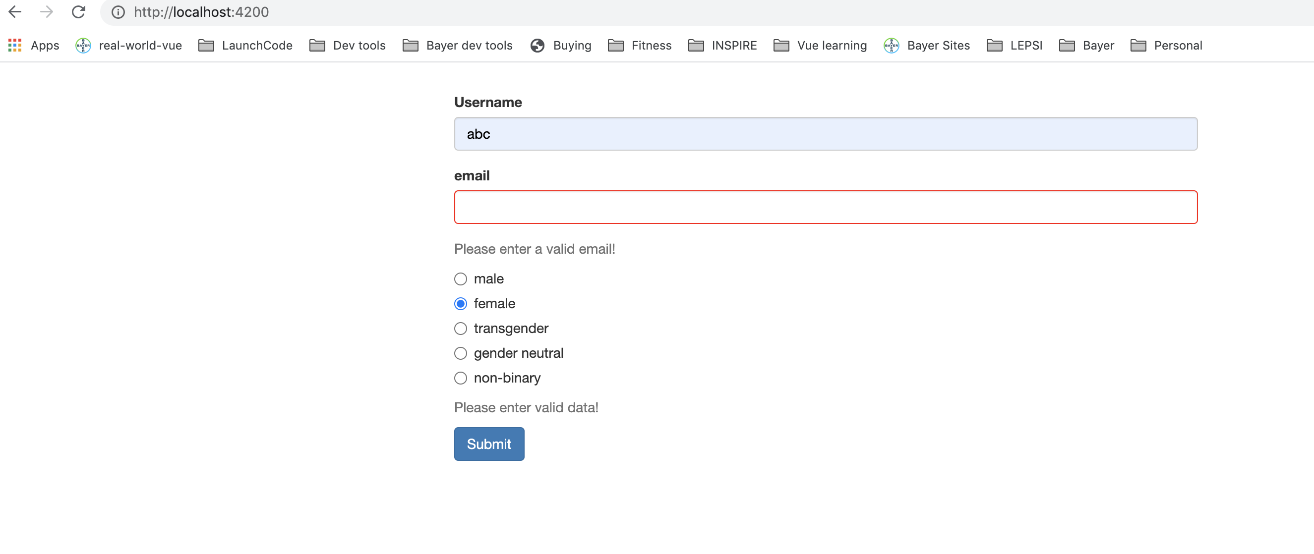
Grouping Controls
Notes:
18

Slide 19
Array of Form Controls.
Notes:
19

Slide 20
Array of Form Controls.
Notes:
20

Slide 21
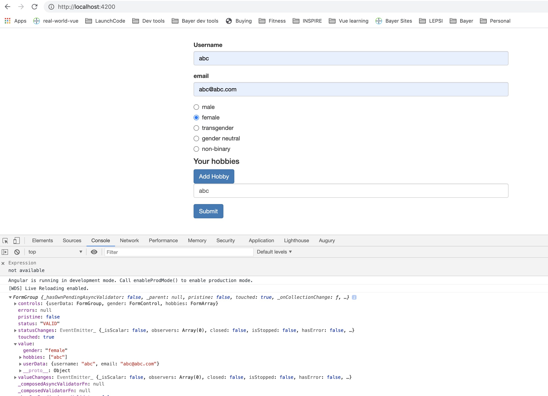
Array of Form Controls.
Notes:
21

Slide 22
Creating Custom Validators
Notes:
22

Slide 23
Creating Custom Validators
Notes:
23

Slide 24
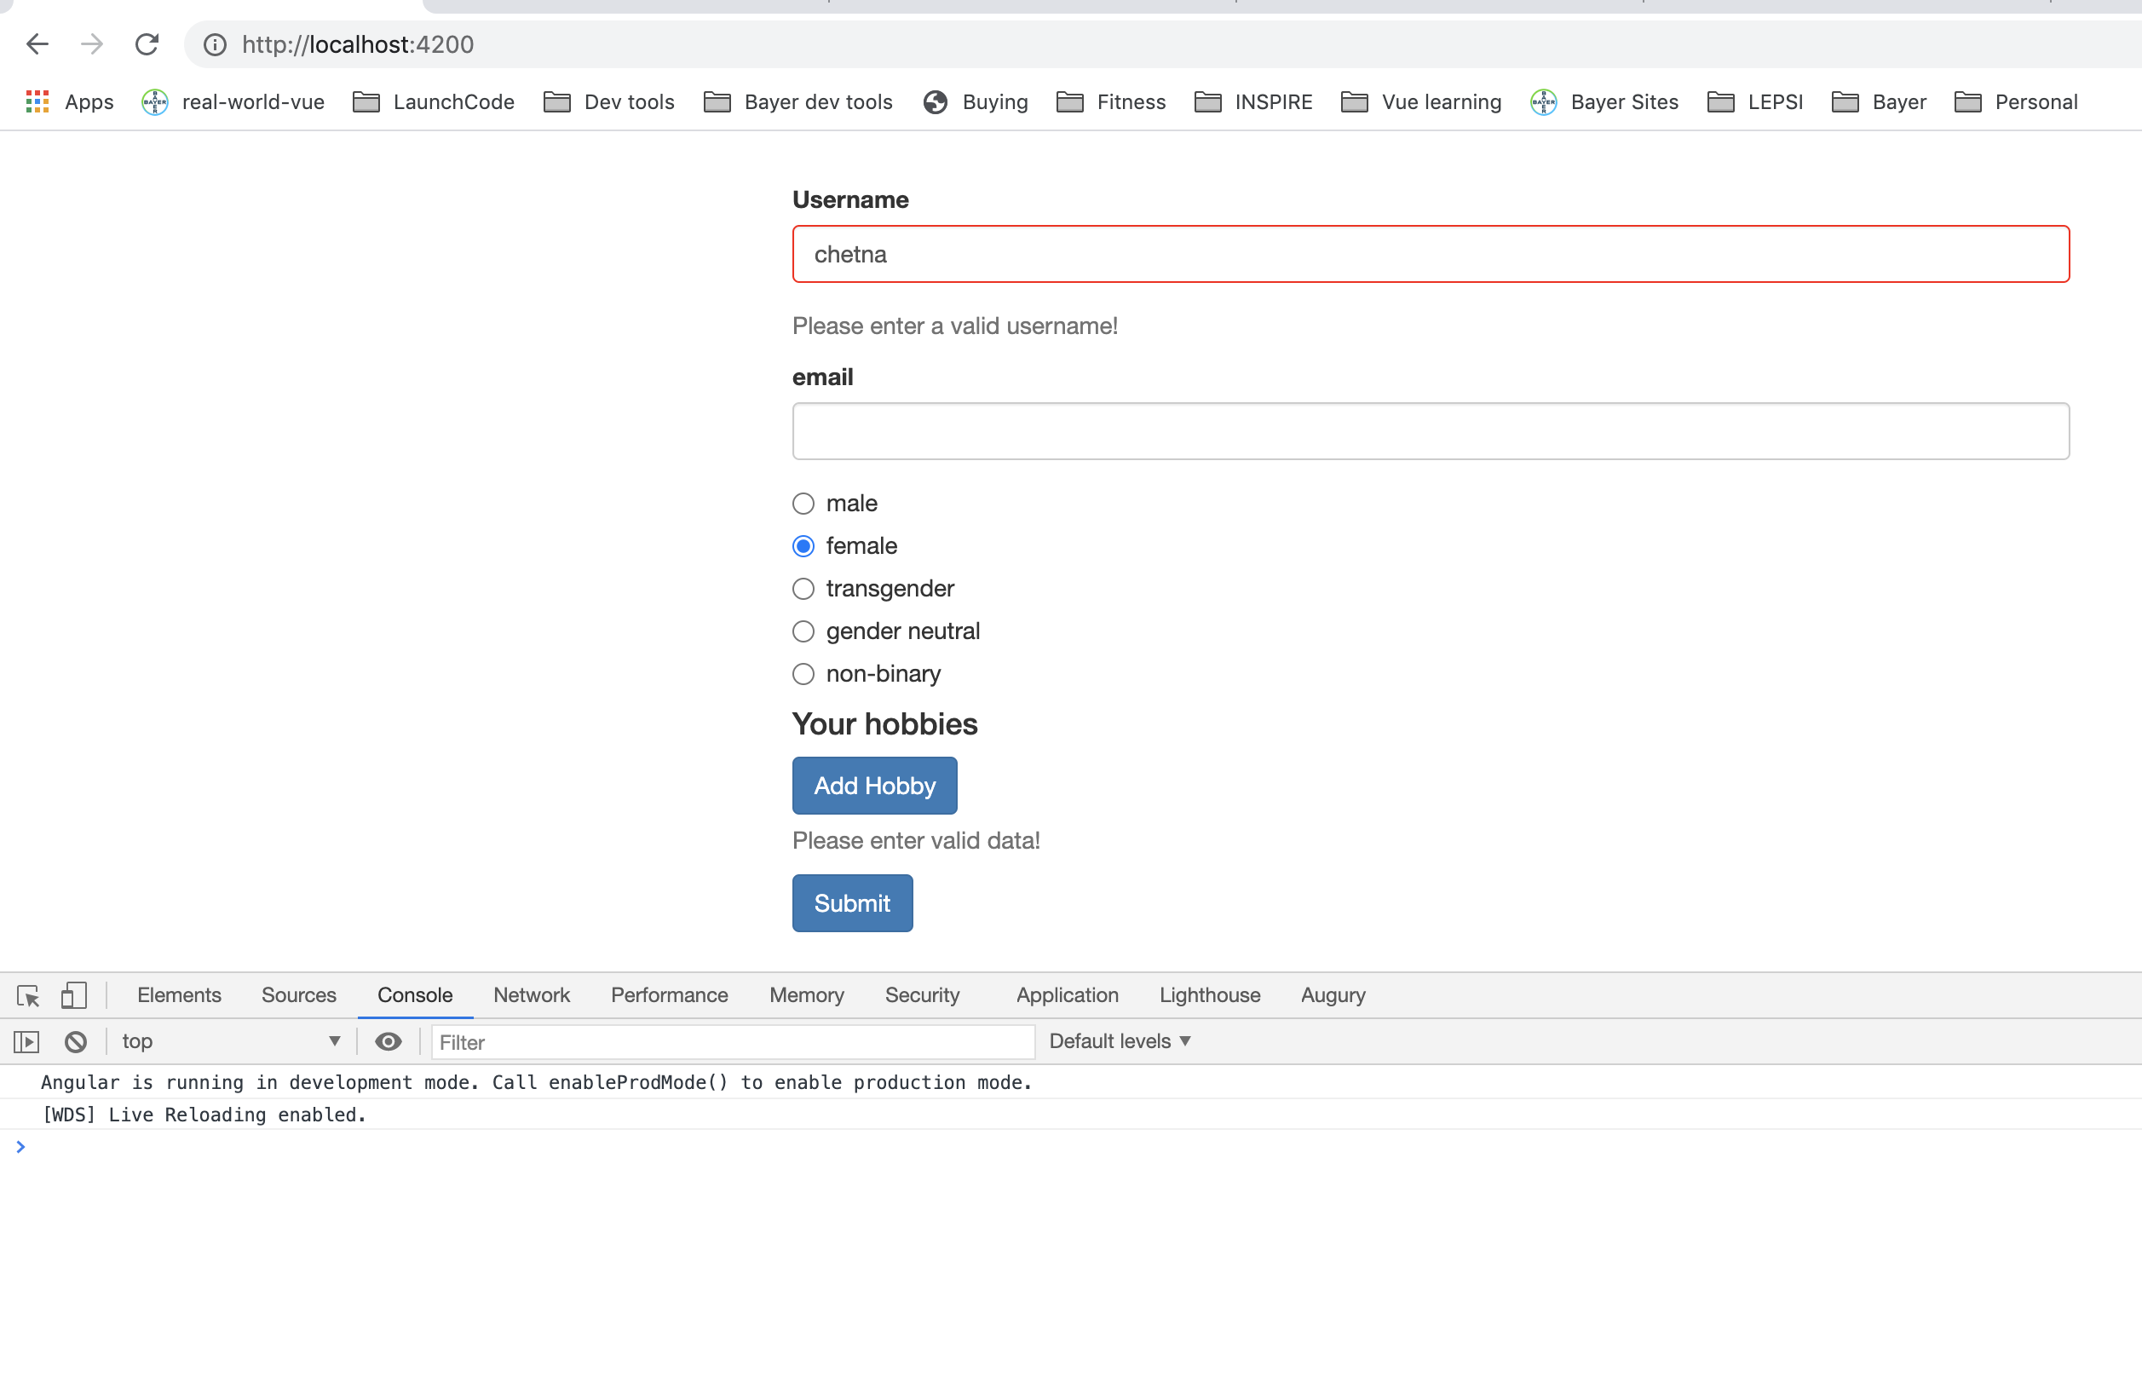
Creating Custom Validators
Notes:
24

Slide 25
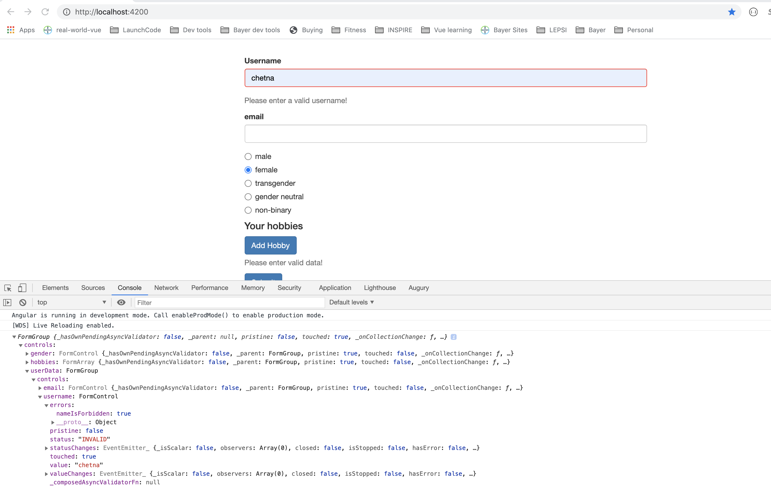
Using Error Codes
Notes:
25

Slide 26
Using Error Codes
Notes:
26

Slide 27
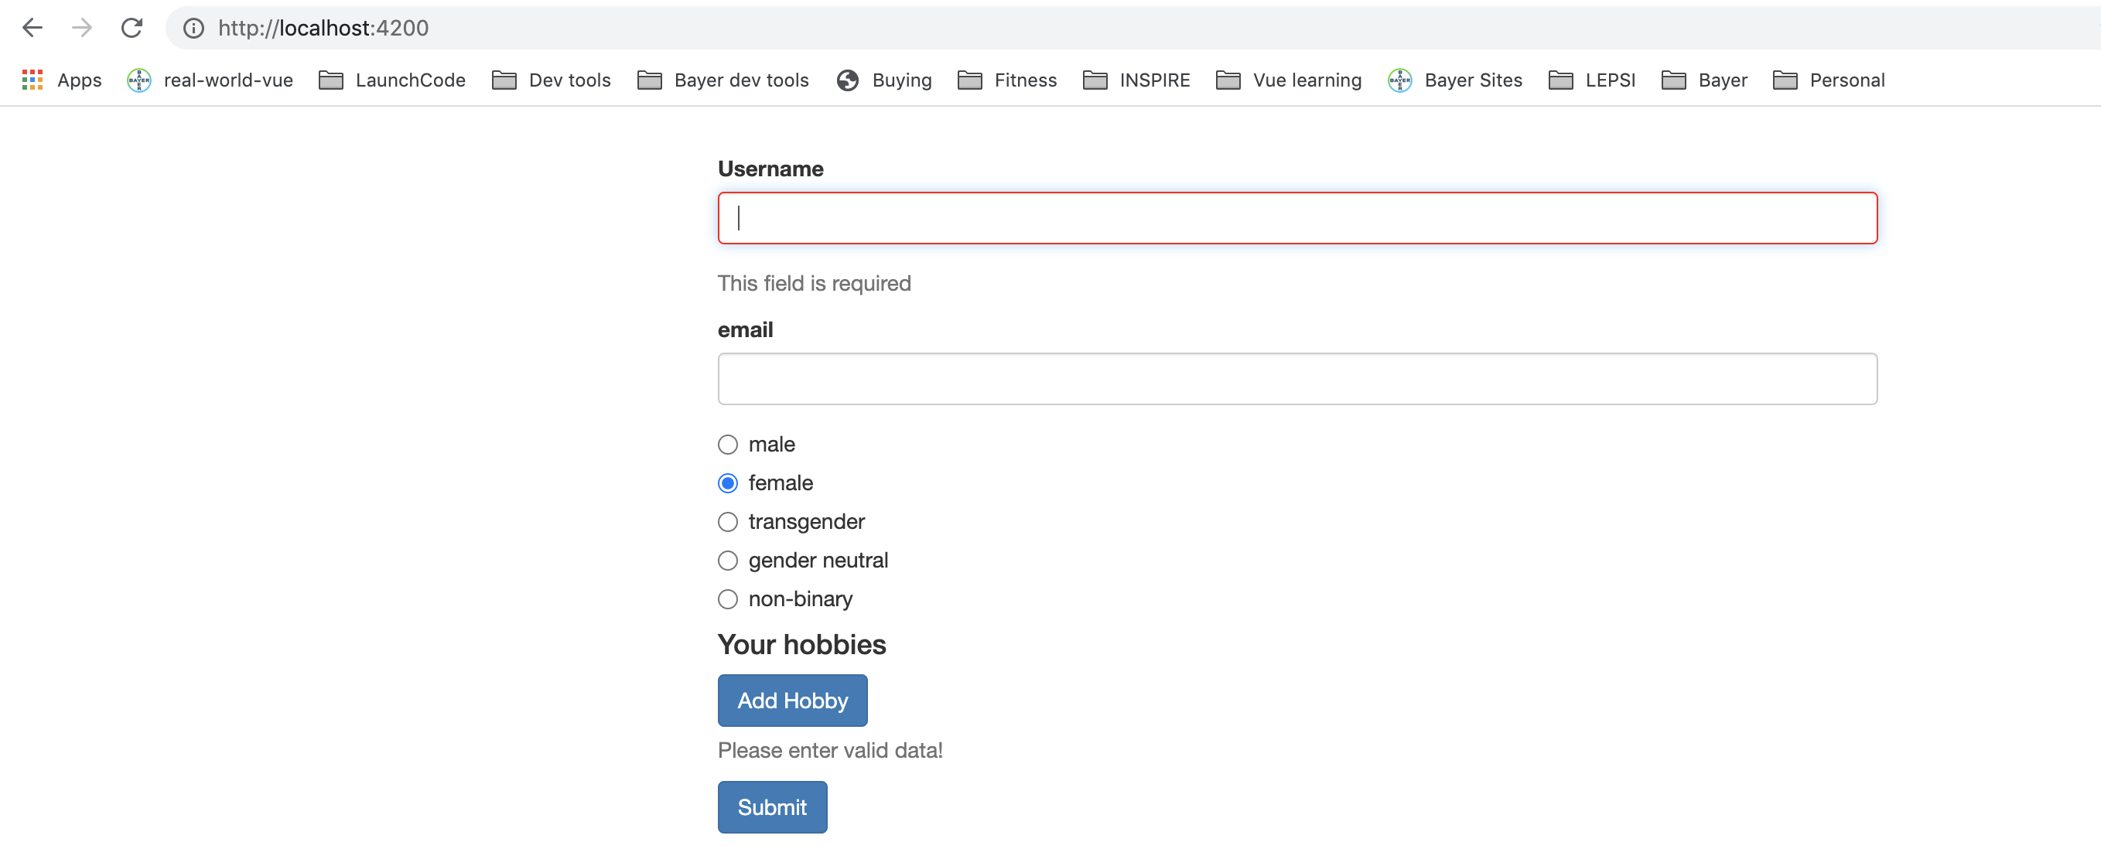
Using Error Codes
Notes:
27

Slide 28
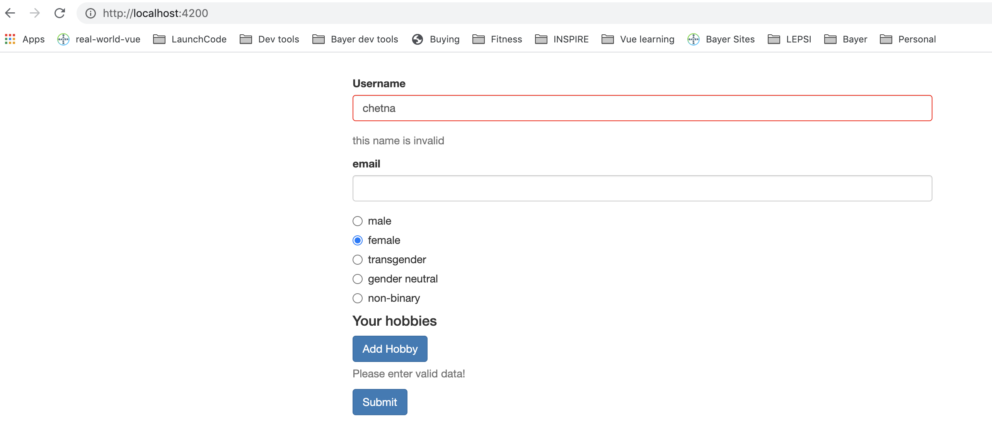
Using Error Codes
Notes:
28

Slide 29
Creating a Custom Async Validator
Notes:
29

Slide 30
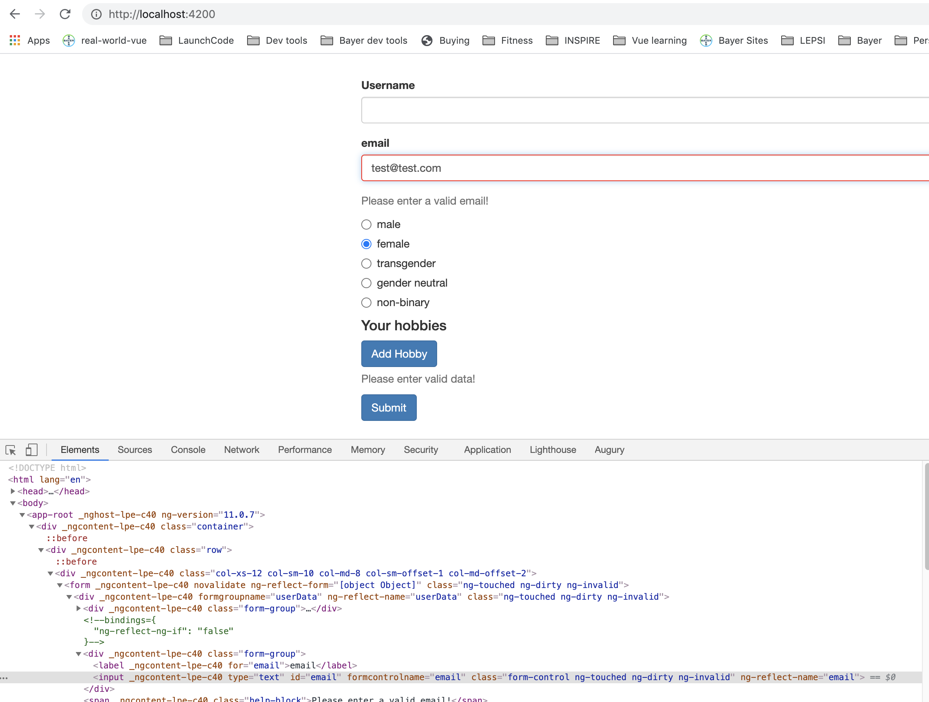
Creating a Custom Async Validator
Notes:
30

Slide 31
Reacting to Status or Value Changes.
Notes:
31

Slide 32
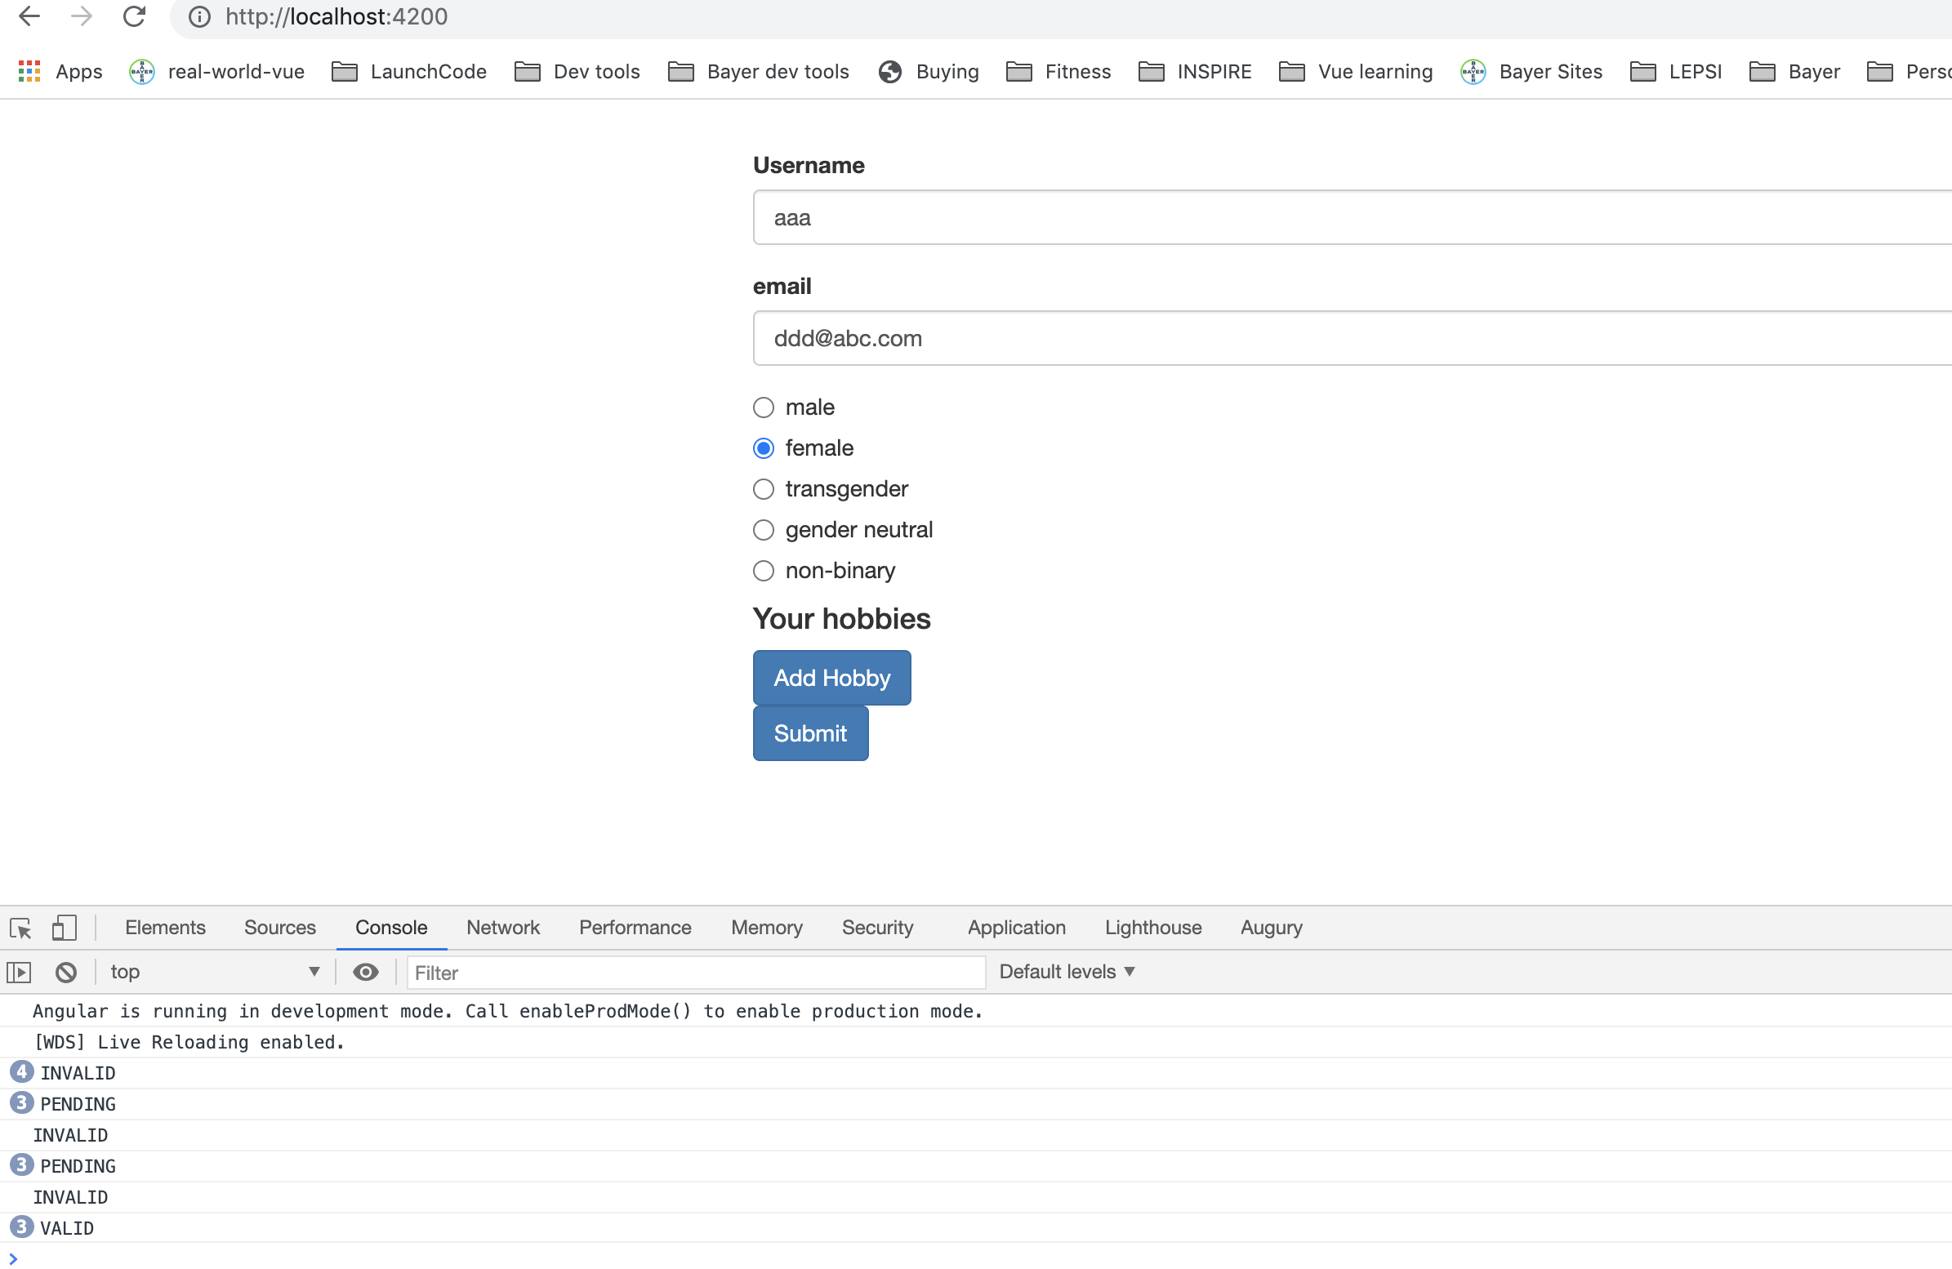
Reacting to Status or Value Changes.
Notes:
32

Slide 33
Setting and patching form values.
Notes:
33

Slide 34
Setting and patching form values.
Notes:
34

Slide 35
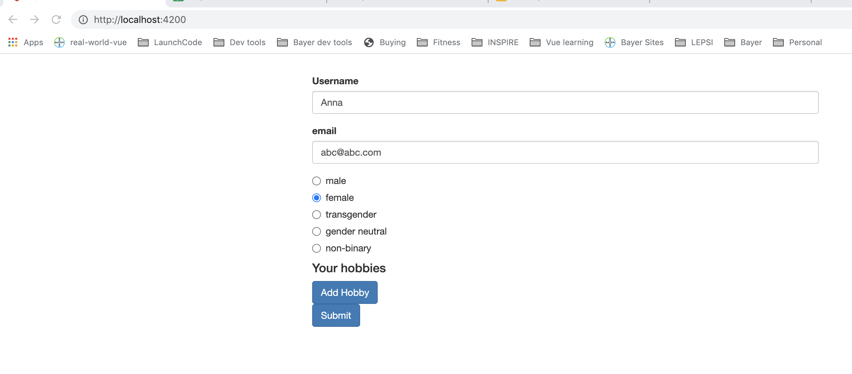
Setting and patching form values.
Notes:
35

Slide 36
Reset form values.
Notes:
36

Slide 37
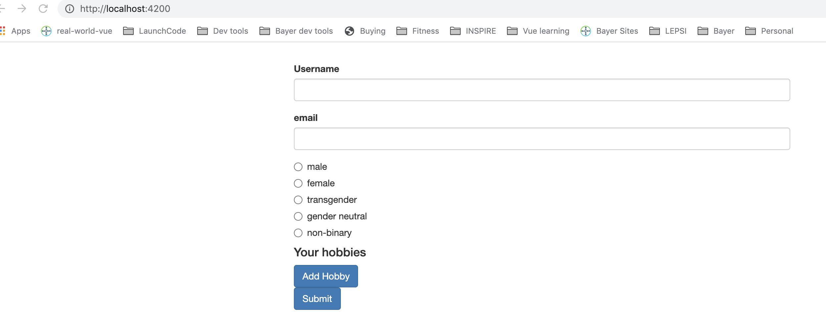
Setting and patching form values.
Notes:
37

Slide 38
Questions?

Slide 39
Studio
Assignment 7: Practicing Reactive Forms
Section 16 - Course Project - Forms

